Slide 1


Secure Your Print Workflow with Dispatcher Phoenix Release2Me
Sales Training
June 2019

Slide 2
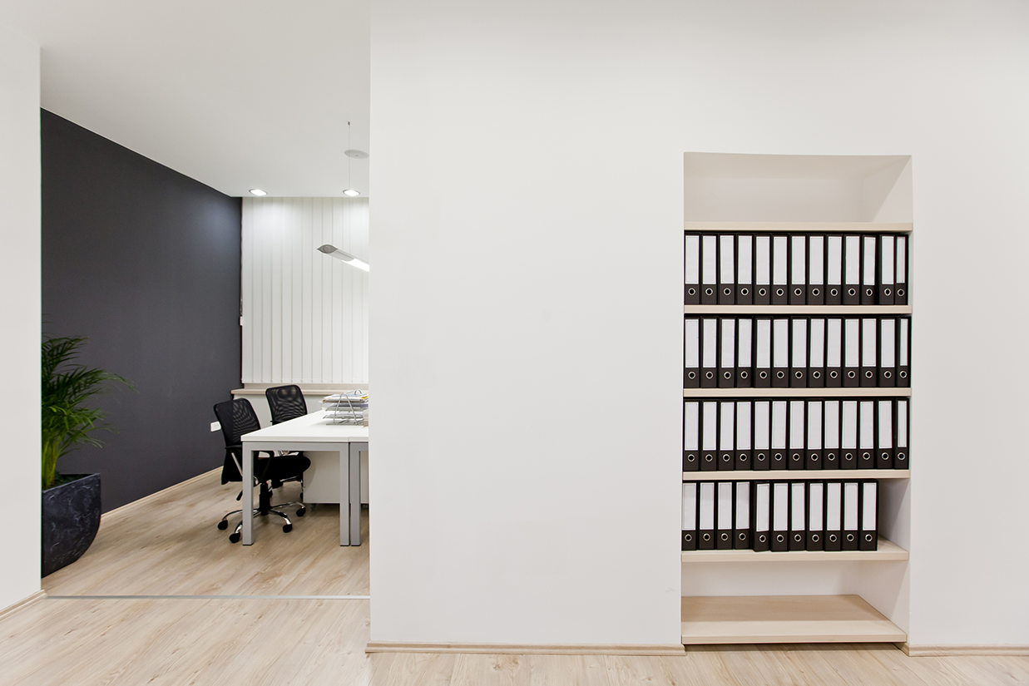

Challenges with Paper Documents
How Dispatcher Phoenix Release2Me Can Help
  Secure Print Release
  Market Placement
  Value Proposition
Release2Me Features
Licensing
Sales & Marketing Resources

Slide 3
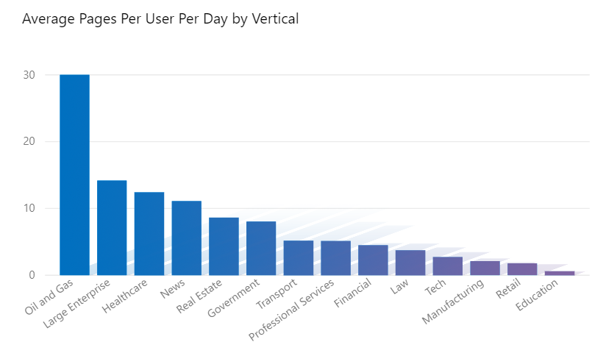
Employees still rely on
Paper-Based Documents
Source: https://www.printaudit.com/printaudit-blog/2015-2016-2017-user-and-device-printer-statistics

Slide 4


The Consequences of
Unwanted Print Jobs
Print documents that get thrown away or recycled the same day they are printed.
Organizations experience serious business risk and/or compliance issues as a direct result of broken document processes
Source: https://printerworkswest.com/blog/226-10-shocking-office-printing-statistics.html

Slide 5

Reducing Waste
Matters
Printing uses energy and trees
But majority of print jobs are never picked up and left abandoned on output tray, or printed single-sided by default
Many times people print information that they don’t really need
Printing waste is an easy place to cut spending
=
WASTED PAPER $$ DOWN THE DRAIN
Source: https://printerworkswest.com/blog/226-10-shocking-office-printing-statistics.html

Slide 6

Security
Matters
Millions of documents are left on printers every year
Documents can be viewed/taken before they can be collected
Personally Identifiable Information (PII) can easily circulate
=
Unattended printouts Major Security Risk
Source: https://printerworkswest.com/blog/226-10-shocking-office-printing-statistics.html

Slide 7


Release2Me
Secure Print Release System
Control exactly when and where you would like your documents printed
Ensure the security of your printouts
Print jobs are held in a queue for release to the authenticated user at the MFP
Choose documents to print, delete any unwanted jobs, and keep documents in queue for future printing

Slide 8



Value Proposition
Release2Me
Scan Workflows
Secure Print Release
Cost Accounting
Collection
Advanced Processing
Distribution
Authentication
Roaming
Charge/Billing
Release Queue
Scan to Me
Scan to Home
Release2Me is the ideal solution for SMBs who do not currently need an expensive print management and cost accounting platform but want a solution for secure print release, delegation and reporting.

Slide 9

Key Features to Control and Secure Printing

Slide 10
Release2Me
System Workflow
Prioritize document security with a pre-configured, easy-to-use workflow!
Using the Release2Me System Workflow, organizations can quickly implement secure pull printing in their day-to-day operations!
With Release2Me:
Print jobs are printed, then held in a print queue, not the MFPs Hard Drive.
Users authenticate into a networked MFP to access their print queue using a password or ID card.
Unclaimed documents can be automatically deleted from the queue after a specified amount of time.
Users can Release, Release & Keep or delete documents from their queue right at the MFP!

Slide 11
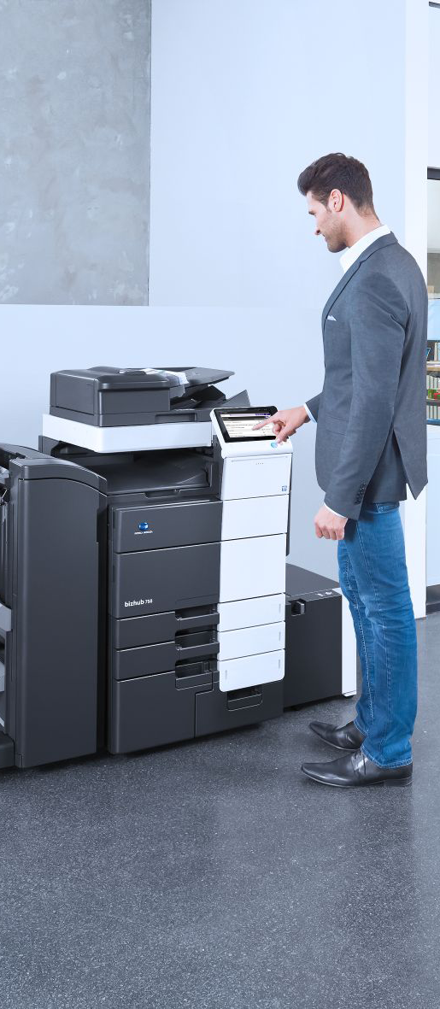
Release2Me
Custom Workflows
Create Unique Workflows with
Advanced Document Processing
Create custom workflows that include additional document processing tasks such as:
  Watermarking
  Annotation
  Redaction
  Highlight/Strikeout
  And more!
Configure automatic notifications to administrators or managers when print jobs are released.
Intelligently route copies of files to long-term storage for future retrieval.

Slide 12
Release2Me
Print Reports
Create & Export Dynamic Release2Me Print Reports
Accumulate data on the most active users, most used devices, peak printing times, and more.
Track print activities by providing records of who prints what, when, where, and how.
Customize reports to analyze or filter print activities during specific date ranges, by user(s), by device(s) or by document name.
Report options include:
Executive
Compare or summarize the print activities of all users, printers, print history within the company.
Device
Compare print activities by device, or analyze each individual printer.
User
Generate print reports to compare specific users or an individual user.

Slide 13
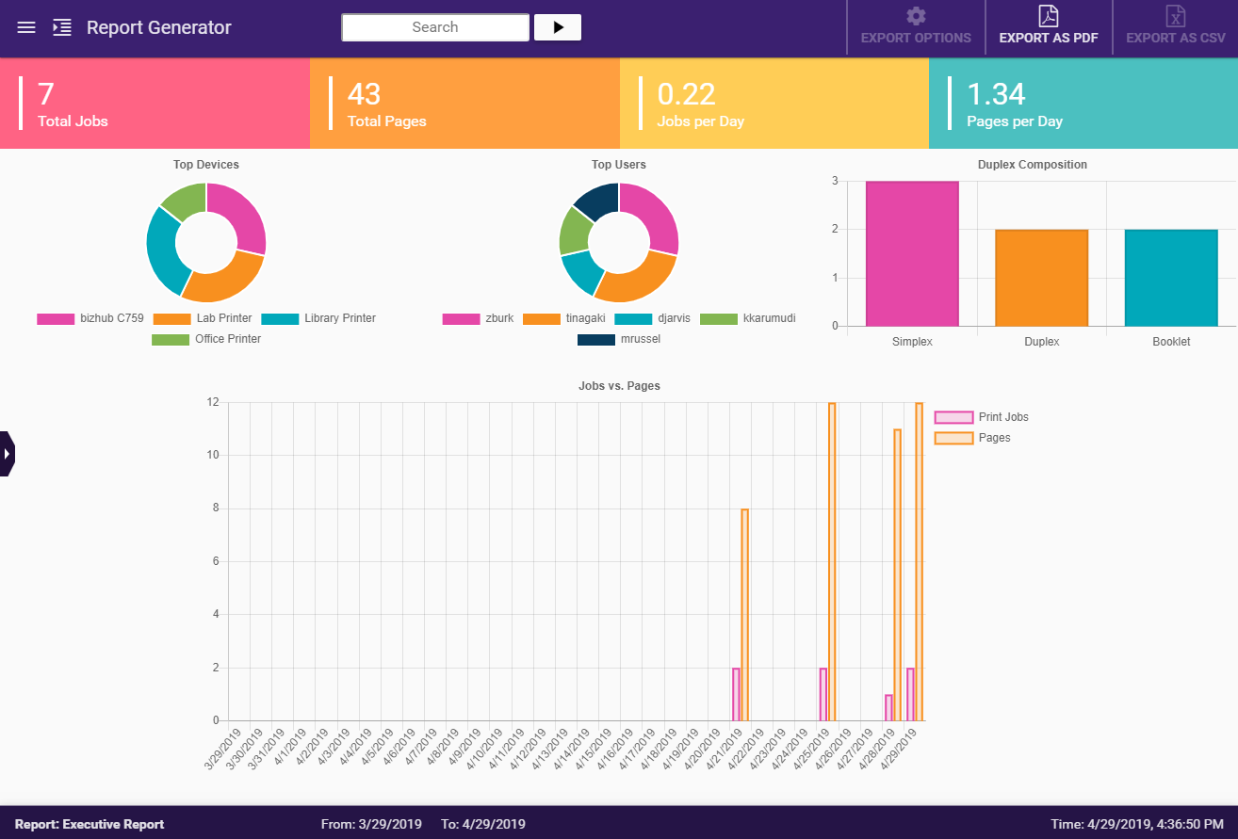
Release2Me
Visual Reports

Slide 14
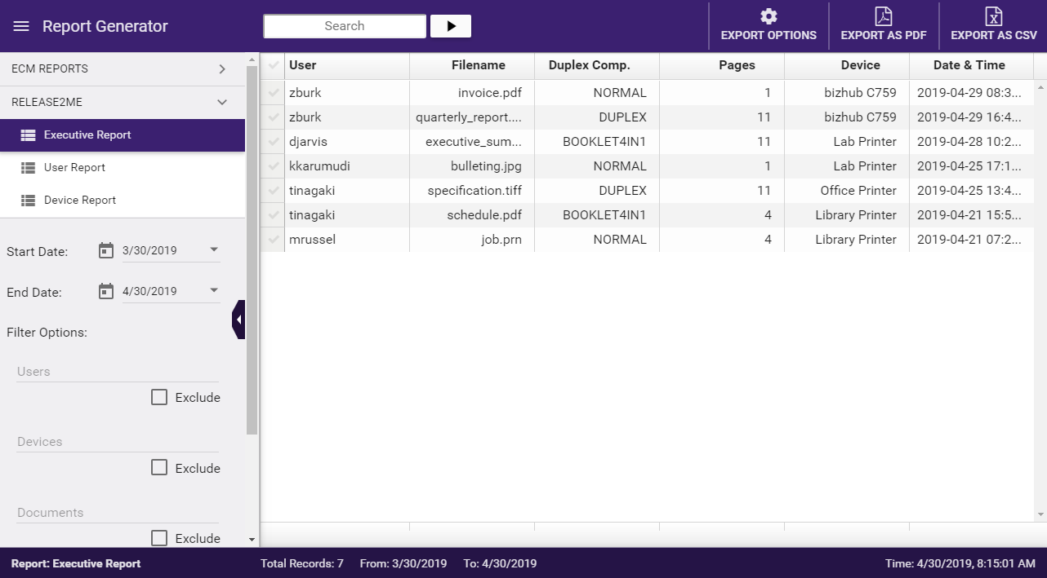
Release2Me
Table Reports

Slide 15

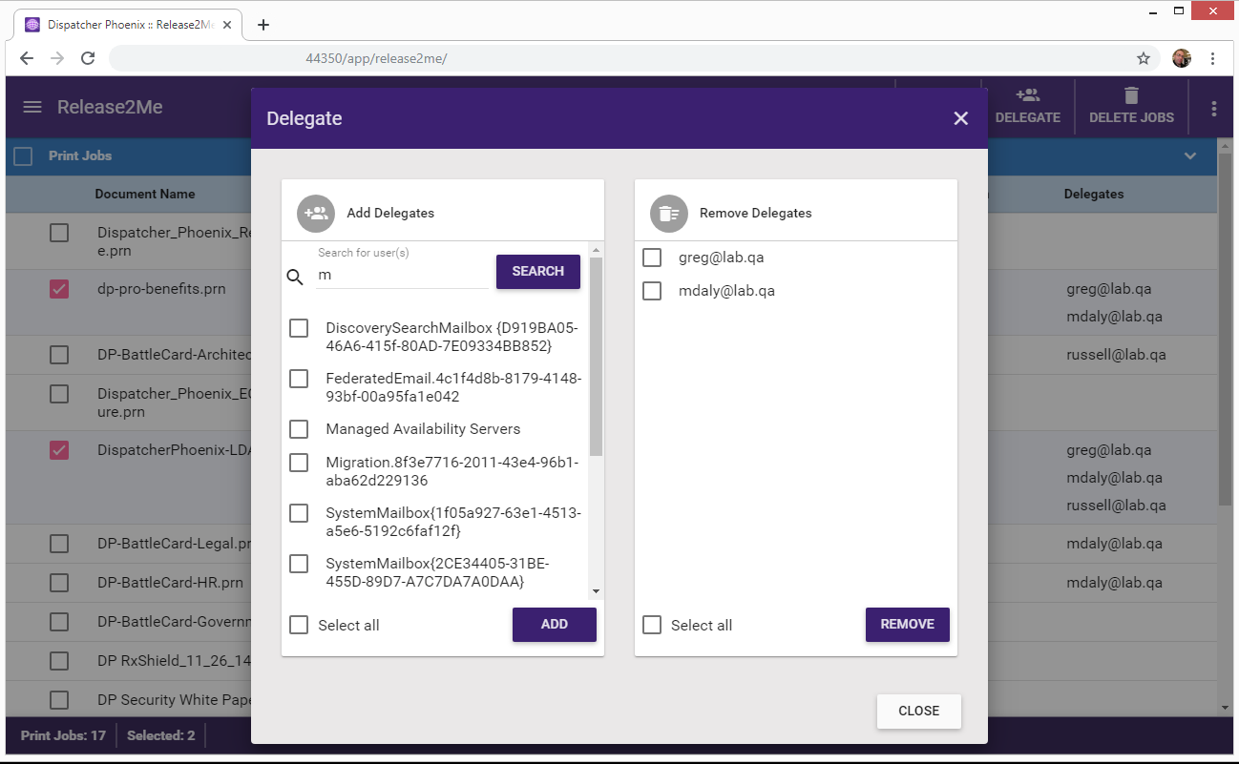
Print Delegation
Web-Based Control
Managers and employees can share or delegate print jobs to ensure teams have the information they need available
to them at the MFP. Busy Managers can delegate their print activities and SMBs can ensure marketing collateral
is available to every employee for on-the-fly printing.
Provides enhanced support for large organizations implementing secure shared printers.
Greater flexibility and power to significantly reduce printing costs.
Advanced web –based control over print queues and further secures print workflows.

Slide 16

Benefits
More Data
Managers Can:
Use data to make decisions, including investing in new technology & evaluating existing technology.
Analyze results in order to address ineffective business processes and print policies.
Proactively respond to changing business needs such as addressing the organization’s need to increase infrastructure or print servers.

Slide 17

Benefits
More Control
Users Can:
Ensure files are readily available for printing from any network printer.
Print others’ jobs without requiring any IT assistance.
Use favorite web browser to manage print queue.
MAJOR BENEFIT:
Instant Security and Cost Savings!

Slide 18
Licensing

Slide 19

Licensing
Simplified Licensing
In addition to Active Inputs, we’ve introduced NEW Device Licensing model for Release2Me!
New Options
DP Release2Me 1 Device License
DP Release2Me 3 Device License
DP Release2Me 5 Device License
DP Release2Me 10 Device License
DP Release2Me 25 Device License
DP Release2Me 50 Device License
DP Release2Me 100 Device License
DP Release2Me 500 Device License
This existing Release2Me optional module now includes THREE Release2Me Device Licenses!
Release2Me Device Licenses include ALL Release2Me functionality!
Device License can only be used for Release2Me workflows. They cannot be used with other types of workflows.

Slide 20

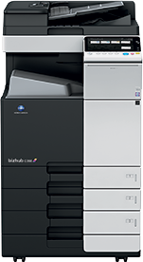
Licensing
Dispatcher Phoenix Foundations
+ 3 Release2Me Device Licenses
Active Input
Device License
Device License
Device License
A Customer with 4 devices can use Dispatcher Phoenix Foundations to scan into a workflow and print to Release2Me using a single Active Input license. Additionally, with 3 Release2Me Device Licenses enabled, the customer can use Release2Me on all 4 devices!

Slide 21
Licensing
3 Devices
For accessing Release2Me on 3 Devices:
Device License
Device License
Device License
Qty. | New Licenses
1 | DP Release2Me 3 Device License

Slide 22
Licensing
15 Devices
For accessing Release2Me on 15 Devices:
Device License
Device License
Device License
Device License
Device License
Device License
Device License
Device License
Device License
Device License
Device License
Device License
Device License
Device License
Device License
Qty. | New Licenses
1 | DP Release2Me 10 Device License
1 | DP Release2Me 5 Device License

Slide 23
Resources

Slide 24
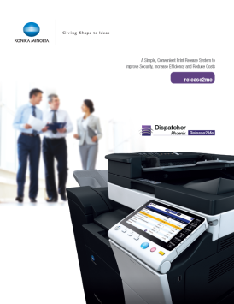

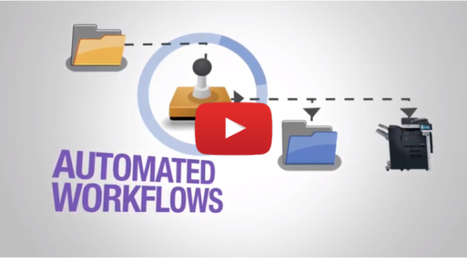
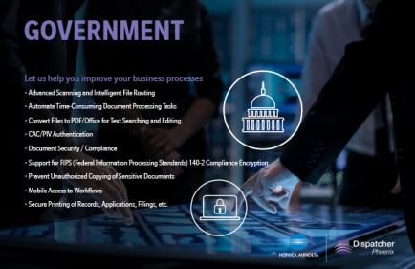
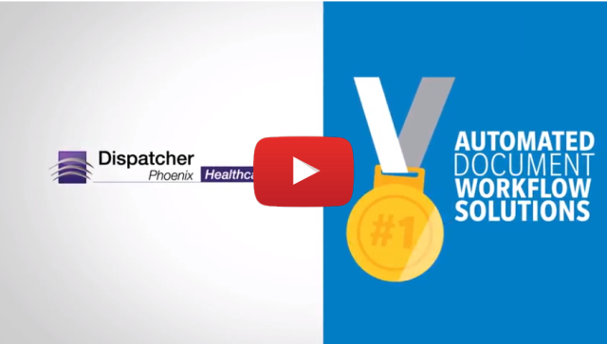
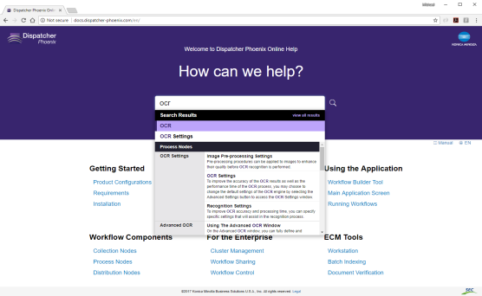
Resources
Brochures
Videos
Web Based Training
Sample Workflows
MFP Simulators
Online Help
30-Day Demo Licenses
(for entire application and for specific nodes)
Presentations

Slide 25
Ordering Information
See the Price Book for details on Dispatcher Phoenix, including main software, main software maintenance, software options, software option maintenance, and professional services.
Annual maintenance is required for all Dispatcher
Phoenix orders for the main software and software options.

Slide 26
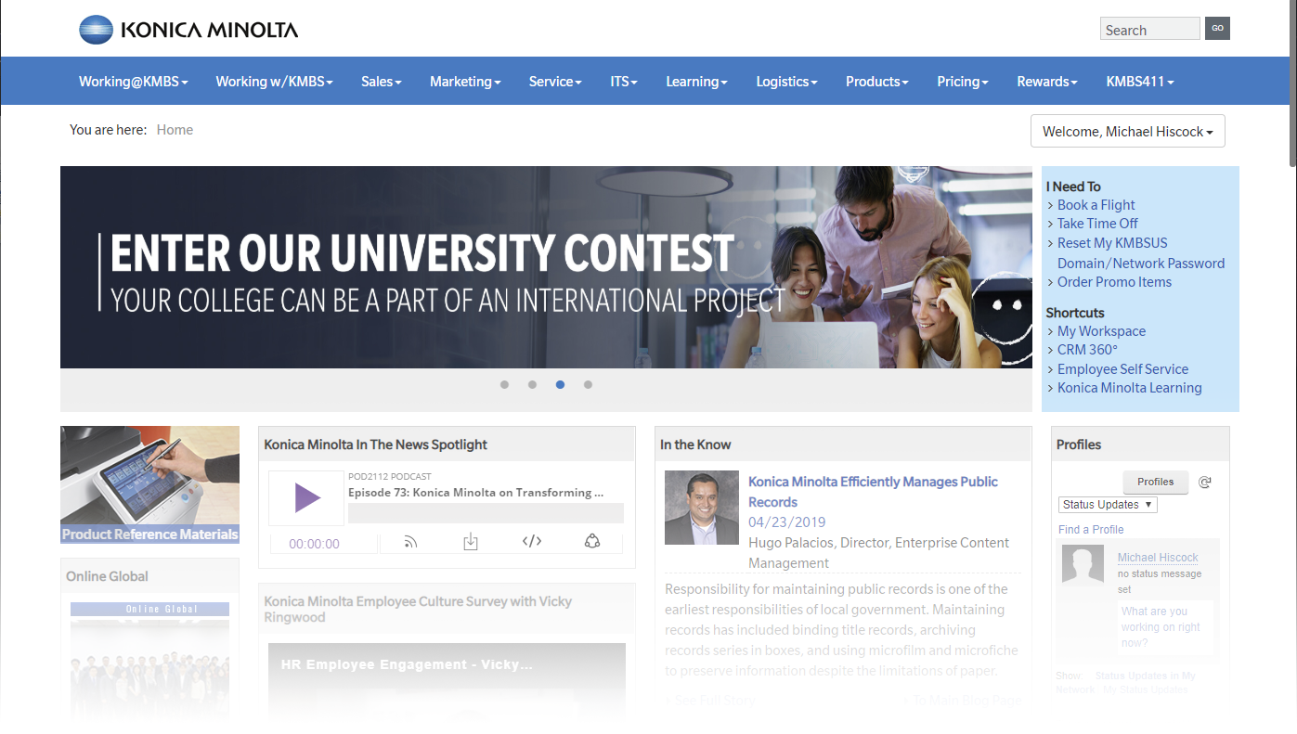
For More Information
www.MyKonicaMinolta.com
Sell Sheets | Presentations | Web Based Training | And More…

Slide 27

Thank You
sec@kmbs.konicaminolta.us

